Slide 1
JSX – Deep Dive

Slide 2
What do you think this is ??
It is neither a string nor HTML

Slide 3
Recall What we Know About JSX?
JSX stands for JavaScript XML.
allows writing HTML in JavaScript.
converts the HTML tags into React elements.
describes what the UI should look like.

Slide 4
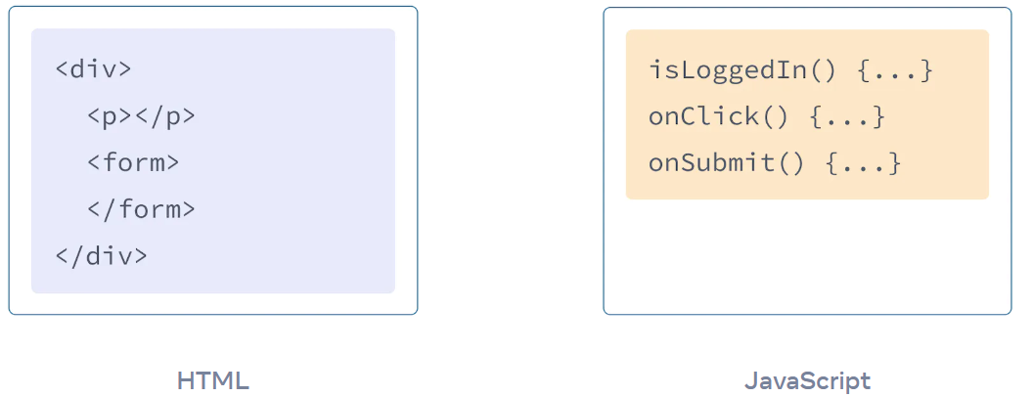
A LONG LONG Time Ago…
The Web has been built on HTML, CSS, and JavaScript.
web developers kept content in HTML, design in CSS, and logic in JavaScript—often in separate files!

Slide 5
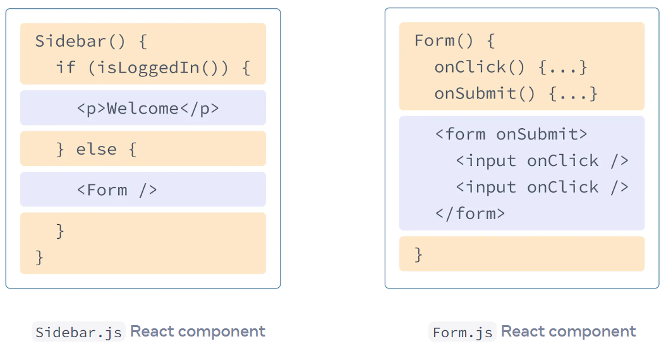
Then web became more interactive
logic increasingly determined content.
JavaScript decided what HTML to Display / Render.

Slide 6
The Rules of JSX
Return a single root element
To return multiple elements from a component, wrap them with a single parent tag such as <div>
Close all the tags
And camelCase

Slide 7
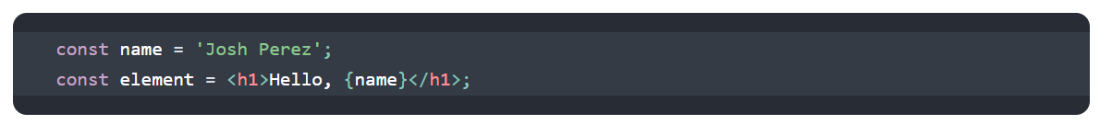
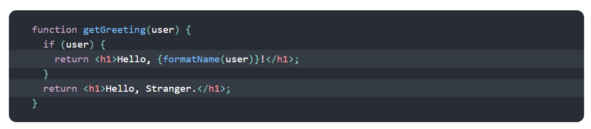
Embedding Expressions in JSX
any valid JavaScript expression can be inside the curly braces in JSX.
JSX is an Expression Too
you can use JSX inside of if statements and for loops, assign it to variables, accept it as arguments, and return it from functions

Slide 8
The Rules of JSX
Return a single root element
To return multiple elements from a component, wrap them with a single parent tag such as <div>
Close all the tags
And camelCase

